Slide 1
WIT –Solution RoadMap
Shout out for help app

Slide 2
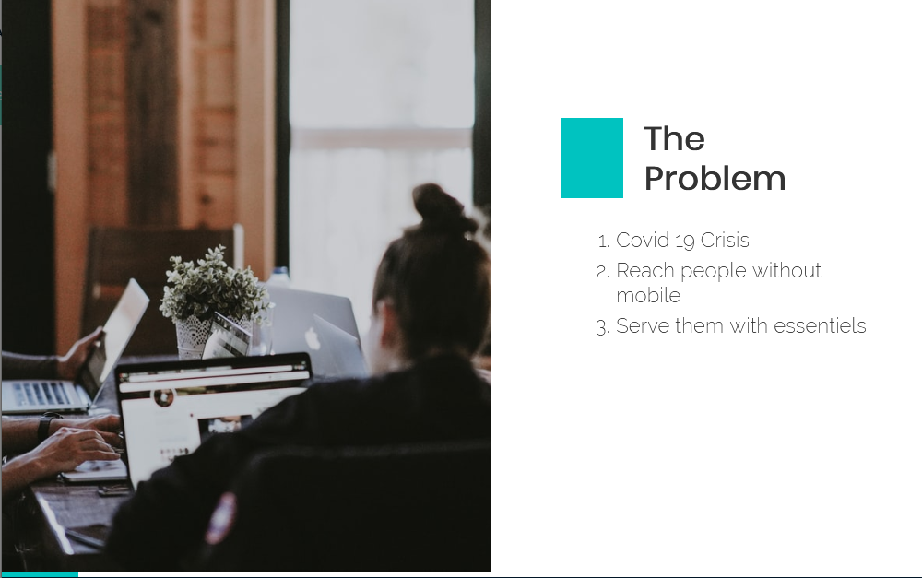

Slide 3
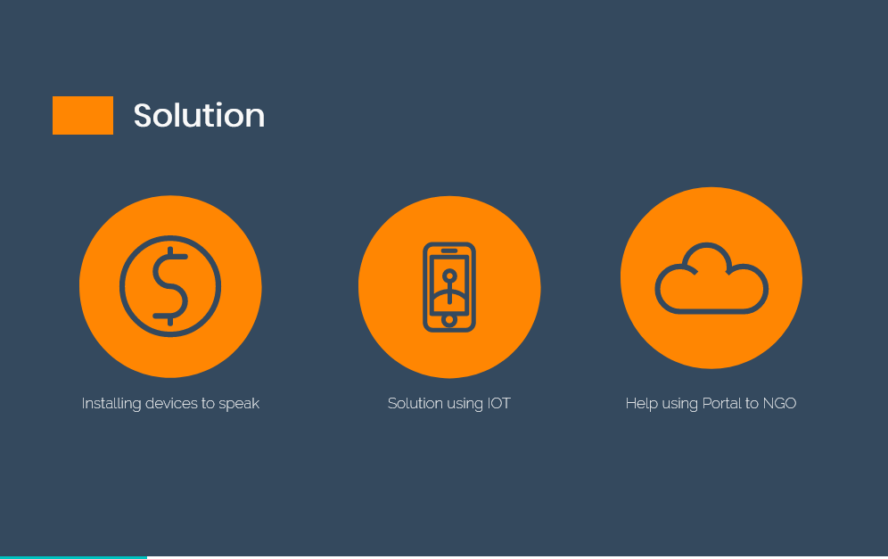

Slide 4
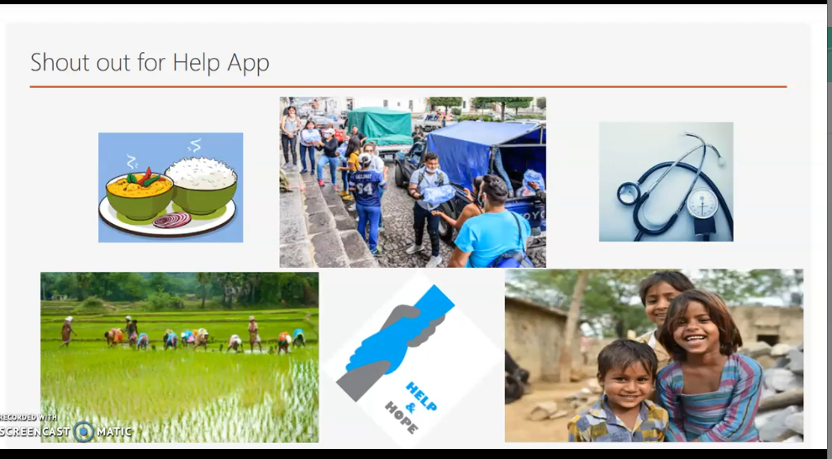

Slide 5
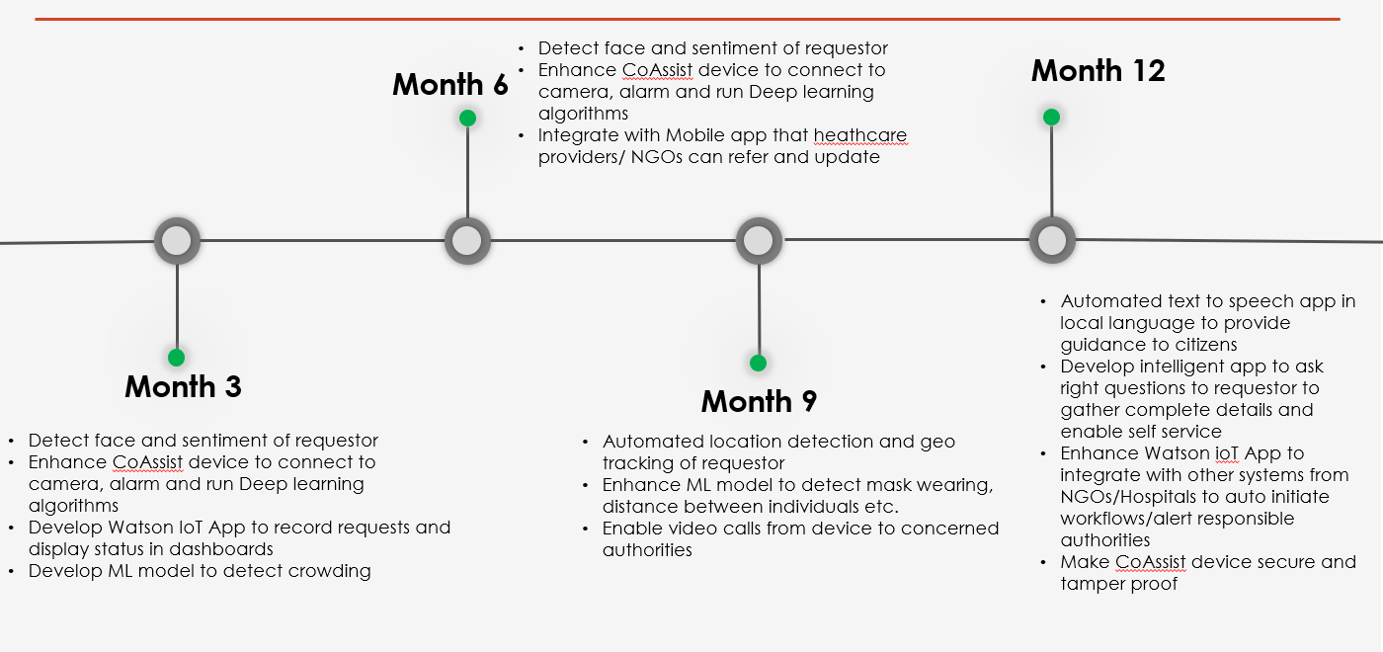
Solution Maturity -Model

Slide 6
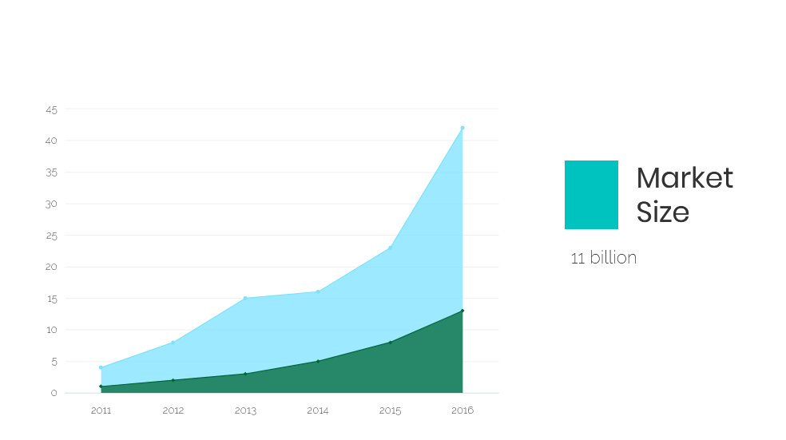

Slide 7
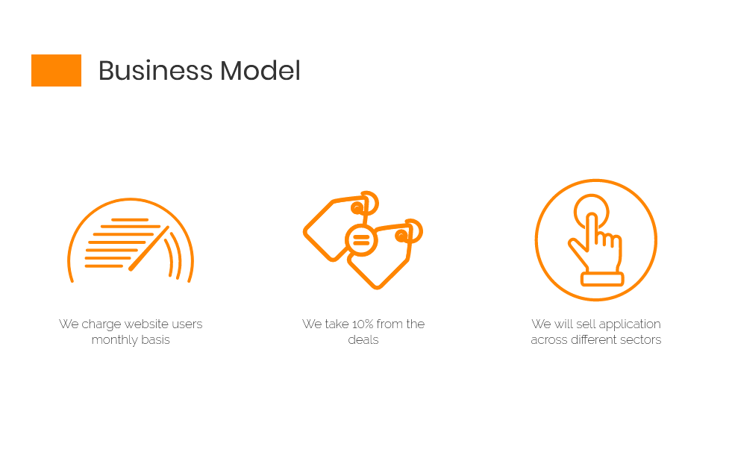

Slide 8


Slide 9
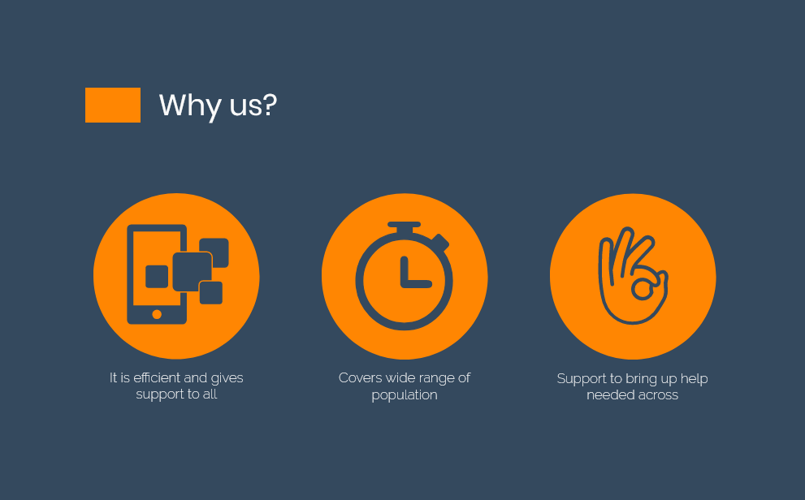

Slide 10
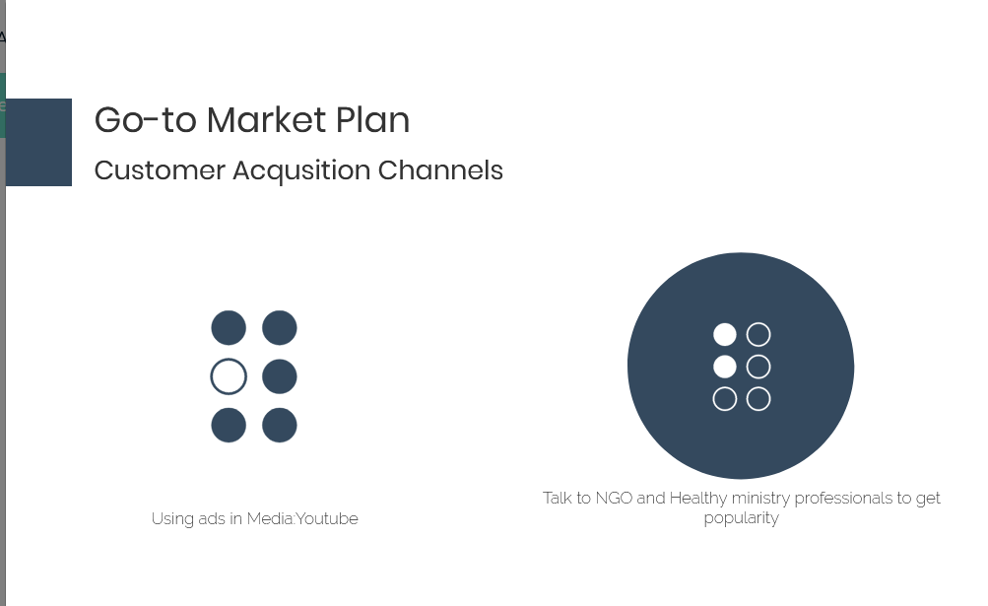

Slide 11
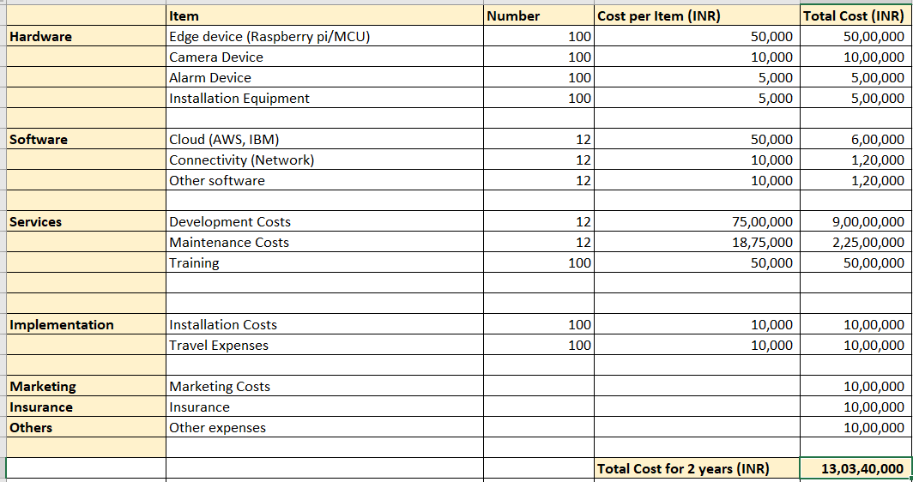
Funding Needs for two years

Slide 12

Sustainability Plan for Our product

Slide 13
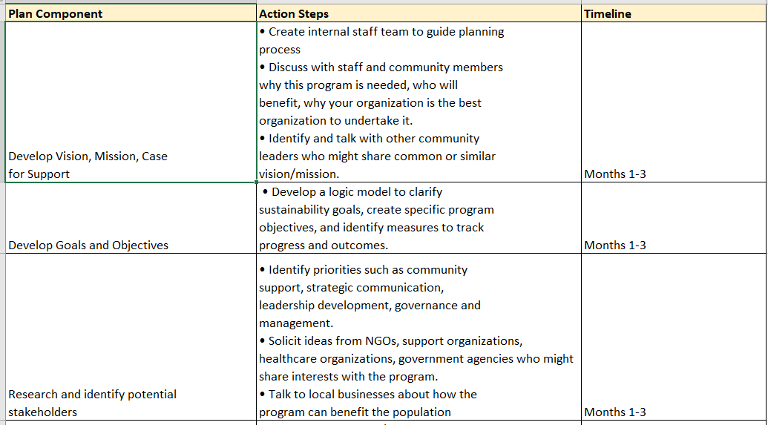
Sustainability Plan-Devolpment-Phase1

Slide 14
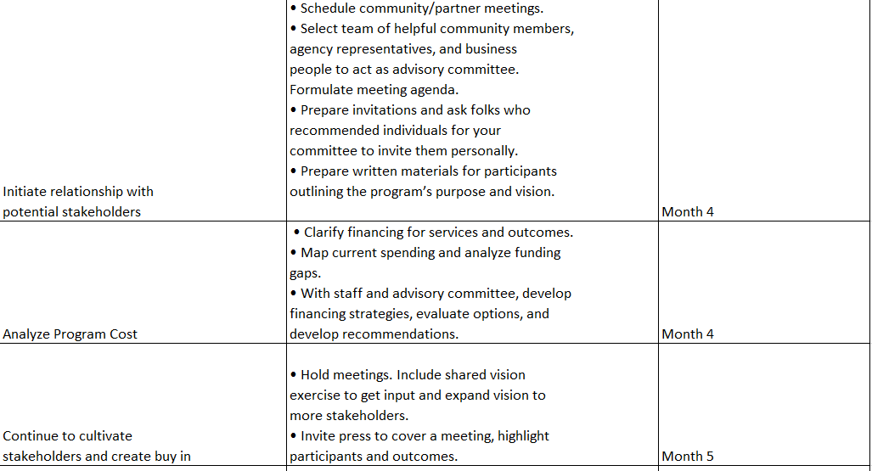
Sustainability Plan-Devolpment-Phase2

Slide 15
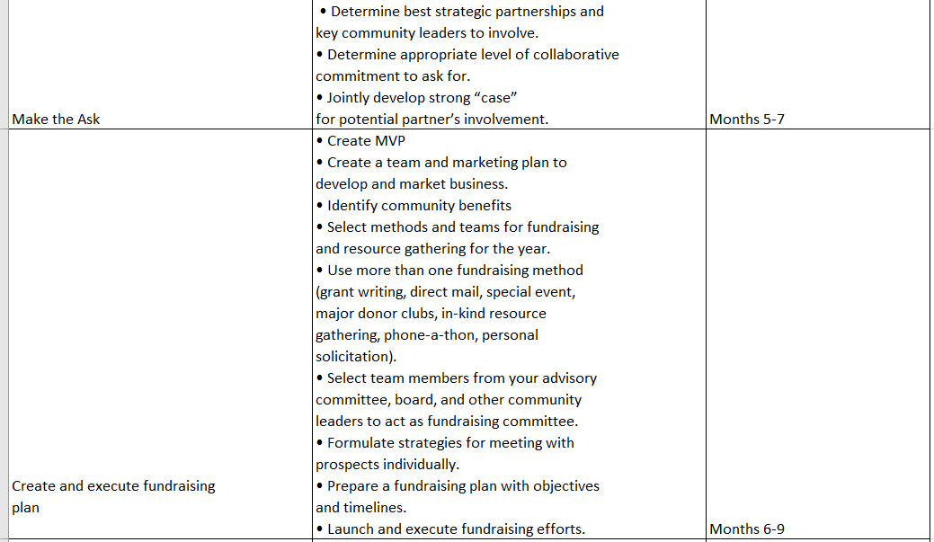
Sustainability Plan-Devolpment-Phase3

